Slide 1
HR Analytics: A Tableau Dashboard Review (2015-2024)
A comprehensive look at hiring, terminations, and workforce trends

Slide 2
Problem Statement:
XYZ Corporation lacks a comprehensive view of employee data, which limits the ability to make informed HR decisions. Objective: To create a Tableau dashboard that will help HR and management visualize and analyse employee data, enhancing the understanding of workforce distribution, performance trends, and salary allocations. Scope: The dashboard will cover employee demographics, department-wise analysis, performance ratings, and salary distribution.

Slide 3
Agenda
📊 Hiring Trends
📉 Terminations by Year
🏢 Department Performance
🌍 Regional Analysis
👥 Demographics: Gender, Age, Education
⭐ Performance Insights
💡 Final Insights & Recommendations

Slide 4
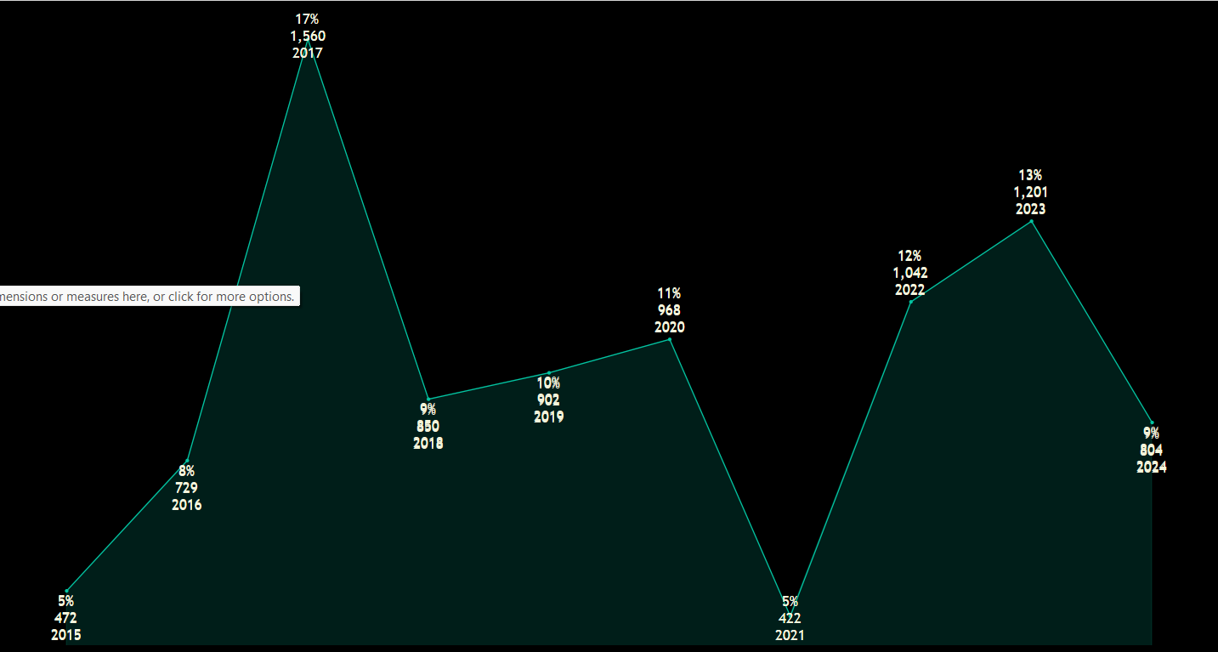
2017 : Highest hiring year with 1,560 hires (17%).
2021 : Lowest hiring year with 422 hires (5%).
2023 : 1,201 hires (13%), followed by a dip in 2024 with 804 hires (9%).
Hiring trend shows cyclic patterns with sharp increases and decreases.

Slide 5
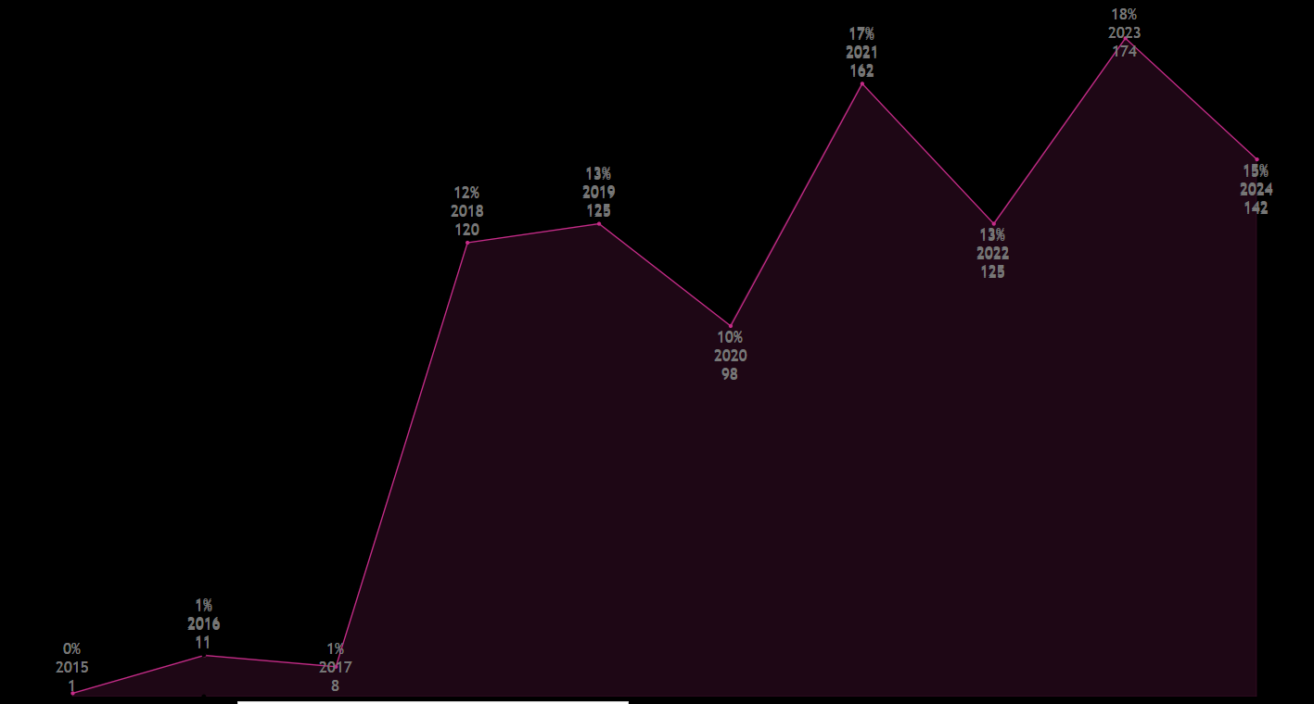
2023 : Highest number of terminations at 174 (18%) ,highest percentage overall.
2021 : 162 terminations (17%).
2015 : Lowest with only 1 termination (0%).
Significant rise in terminations in 2021 and 2023 after a dip in 2020 (98 terminations, 10%).

Slide 6
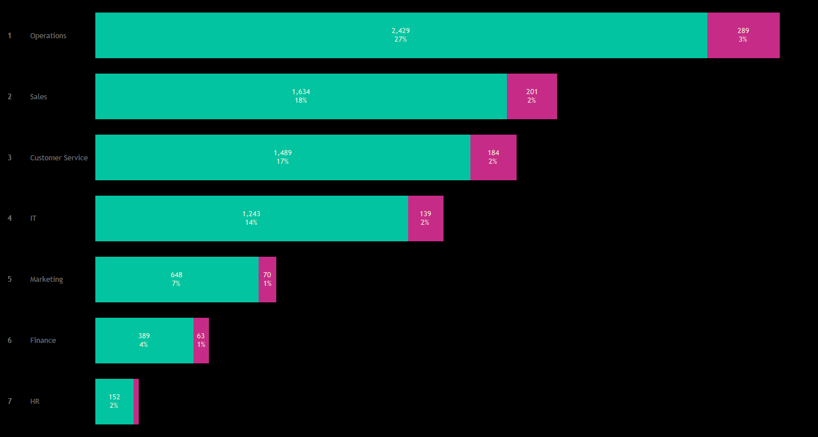
Operations : 2,429 hires (27%) with 289 terminations (3%); highest turnover.
Sales : 18% hires and 2% terminations; high demand, moderate turnover.
Customer Service : 17% hires, 2% terminations; similar to sales.
IT : 1,243 hires (14%), 139 terminations (2%); stable workforce.
Marketing, Finance, HR: Fewer hires but low turnover; stable workforce.

Slide 7
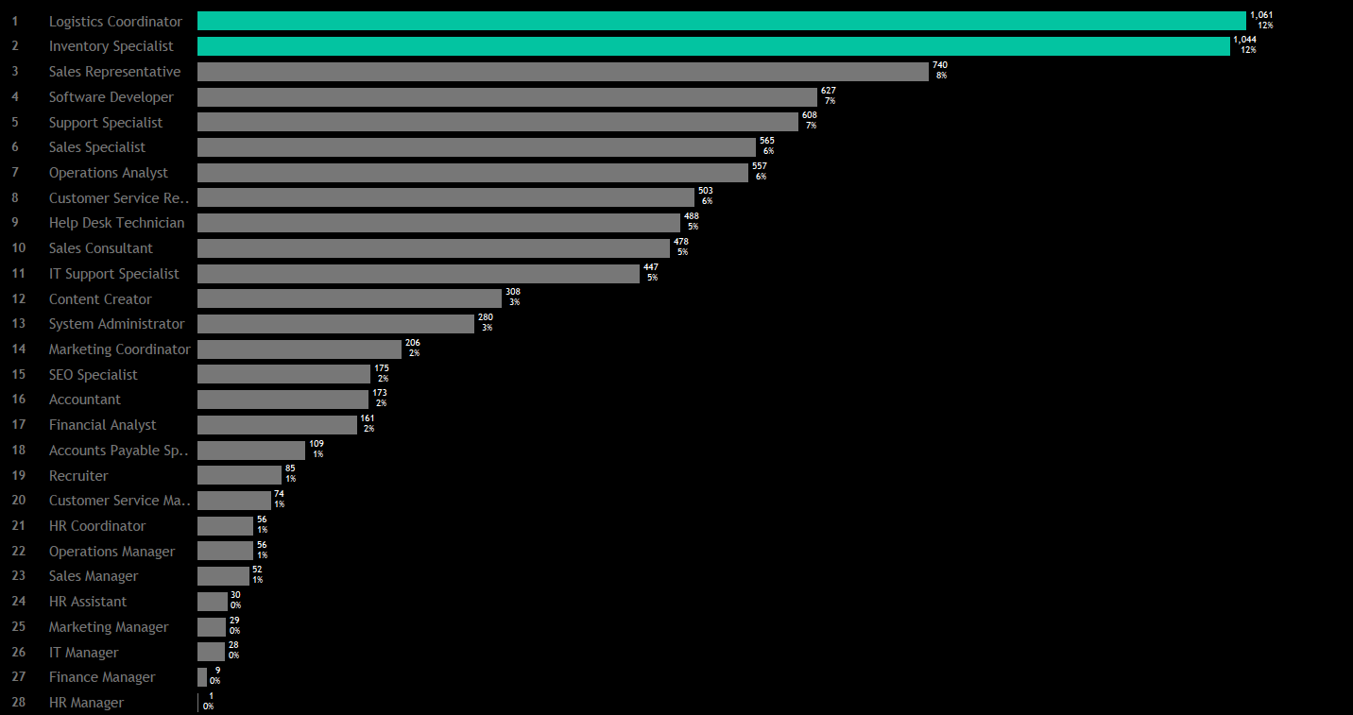
Top Hires : Logistics Coordinator and Inventory Specialist (12% each).
Mid-Tier : Sales Representative(8%), Support Specialist(7%), and Operations Analyst (6%).
Lower Hires: System Administrator(3%), SEO Specialist (2%).
Focus on roles with higher hiring volumes; prioritize critical positions.

Slide 8

New York: 70% of total hires (6,270 hires); major hub.
Michigan: 11% of hires (976 hires); significant but much smaller.
Other states: Pennsylvania, North Carolina (5% each); lower hiring in states like Illinois and Ohio.
Regional focus in New York with potential expansion opportunities in smaller states.

Slide 9
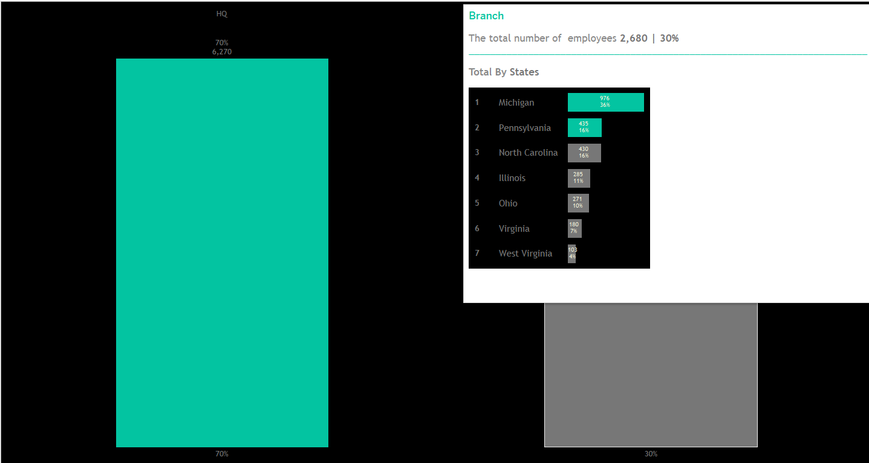
Headquarters (New York): 70% of total hires (6,270); centralized workforce.
Branches: 30% of total hires (2,680); Michigan is the largest branch.
Shows a centralized business model with smaller satellite operations.

Slide 10
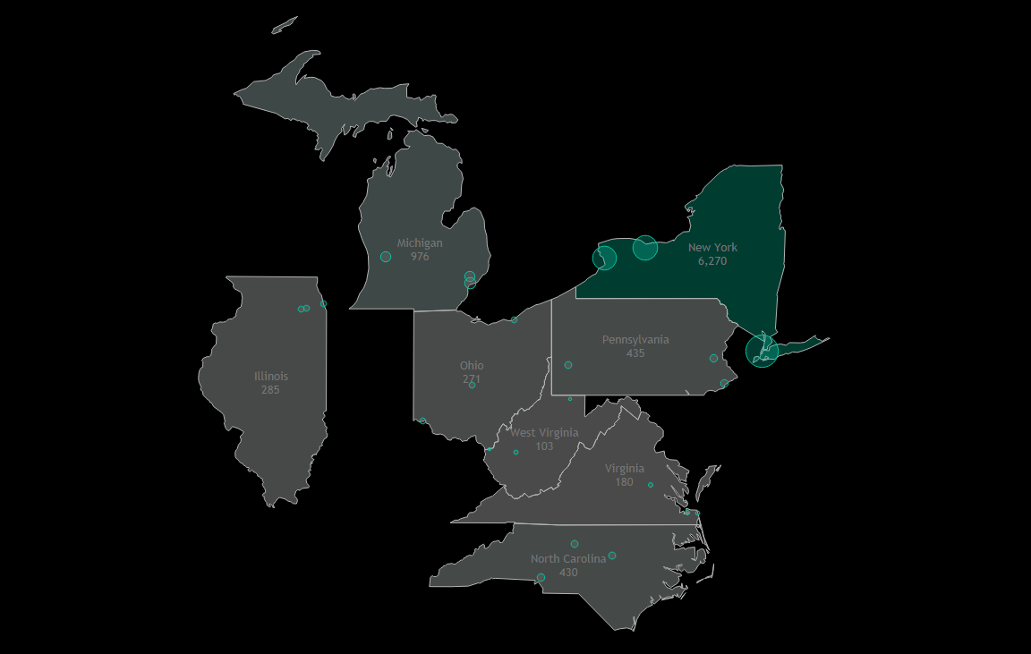
New York : Dominates with 6,270 hires.
Michigan : Significant hub with 976 hires.
Lower hiring in states like Virginia (180 hires) and West Virginia (103 hires).
Emphasizes potential for regional growth and resource allocation.

Slide 11
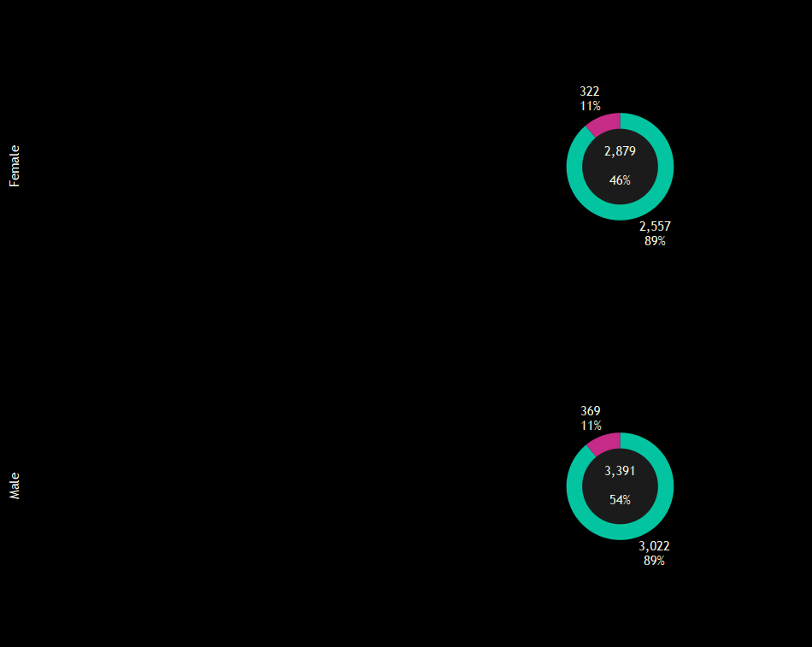
Male: 54% of total workforce; 11% termination rate.
Female : 46% of total workforce; 11% termination rate.
Balanced gender distribution with similar hiring/termination rates.

Slide 12
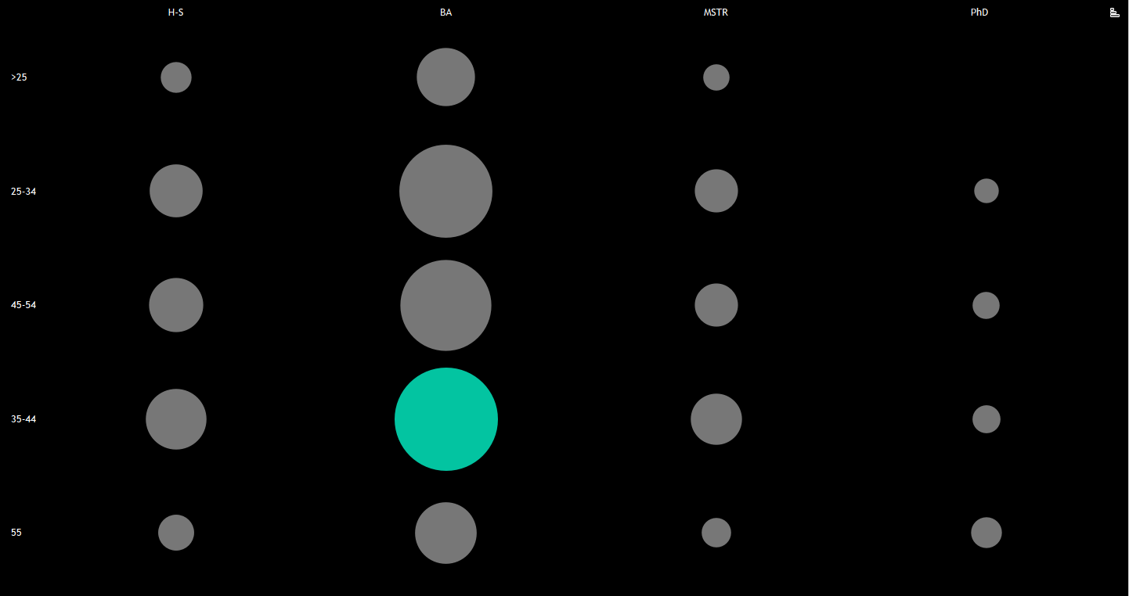
35-44 with BA: Largest group.
PhD holders: Few hires across all age groups.
High School: Lower representation, but present in 35-54 age groups.

Slide 13
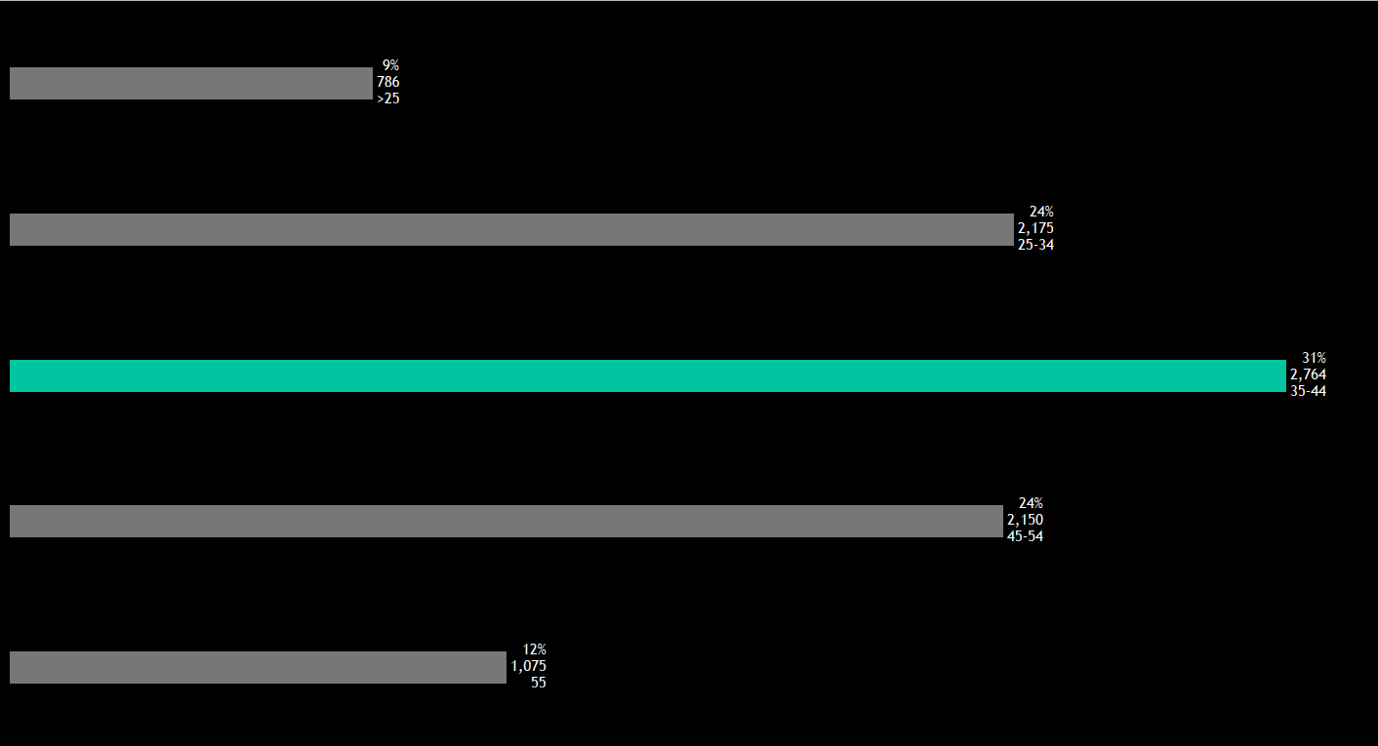
35-44: Largest hiring age group (31%).
25-34 and 45-54: Both account for 24% of hires each.
20-24: Smaller proportion (9%);
Limited intake of younger employees.

Slide 14
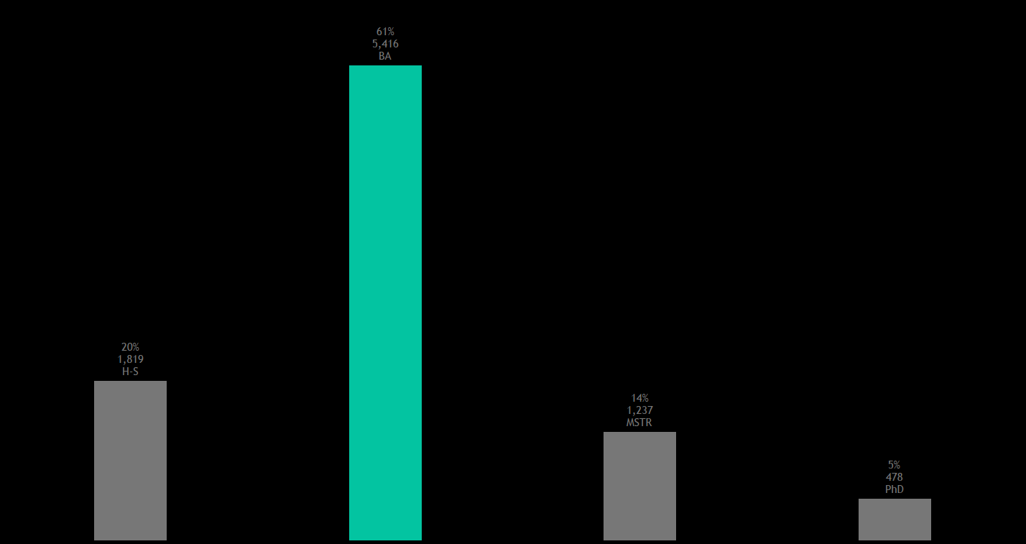
BA: 61% of hires; dominant in hiring.
High School: 20% of hires; significant for entry-level roles.
Master's and PhD: Smaller portions but reflect specialized roles.

Slide 15
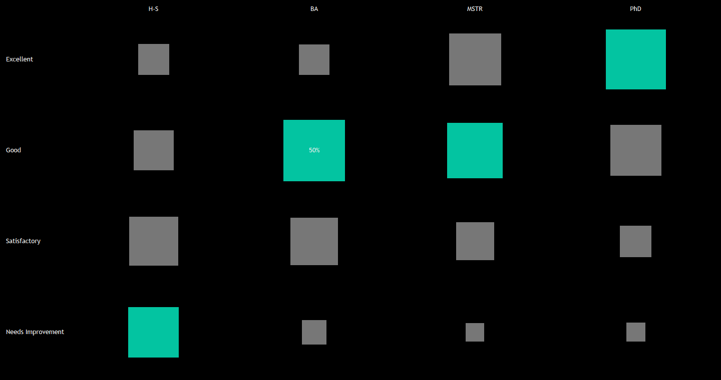
Higher education levels, such as PhD, correlate with higher performance ratings (Excellent).
Bachelor’s degree holders tend to perform well, with many rated as "Good."
Individuals with only a high school education are more likely to require improvement.

Slide 16
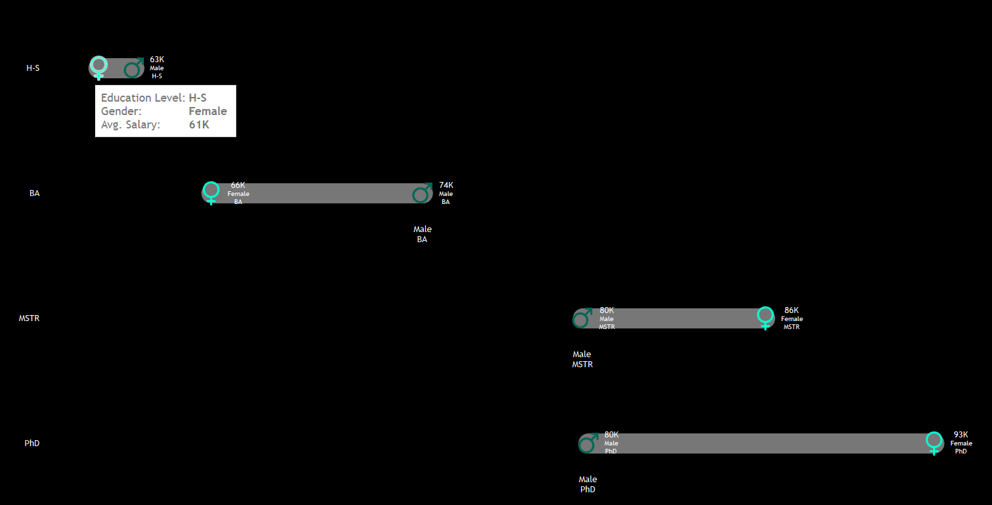
Males earn slightly more at high school and bachelor’s degree levels.
Females earn significantly more at master’s and PhD levels, with the gap widest at the PhD level.
Higher education correlates with higher salaries.
Females benefit more from advanced degrees compared to males.

Slide 17
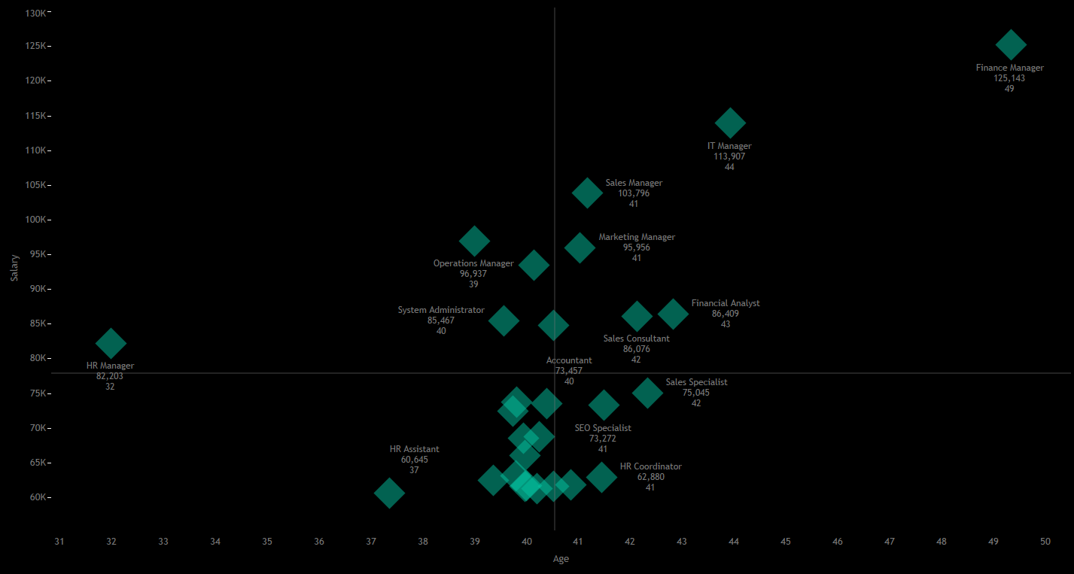
Highest Paying Roles:
Finance Manager: $125,143 (Age 49)
IT Manager: $113,907 (Age 44)
Sales Manager: $103,796 (Age 41)
Marketing Manager: $95,956 (Age 41)
Salaries typically range from $95K to $125K for these roles.
Mid-range Salaries:
Operations Manager: $96,937 (Age 39)
System Administrator: $85,467 (Age 40)
Salaries: $85K to $100K
Lower Salary Roles:
HR Assistant: $60,645 (Age 37)
HR Coordinator: $62,880 (Age 41)
Lowest salaries despite age
Similar Salaries, Different Ages:
Sales Specialist: $75K (Age 42)
Accountant: $75K (Age 40)
SEO Specialist: $73,000 (Age 41)
Summary:
Older age and senior roles generally mean higher salaries.
Job title significantly impacts salary, even at similar ages.
Higher salaries generally correspond with older employees, especially after age 40.
Positive correlation between age and salary in most cases.

Slide 18
FinalHR Insights & Recommendations for Growth Insights & Recommendations
HR Insights & Recommendations for Growth
• High turnover in critical departments: Operations & IT
• Centralized workforce—diversify into smaller regions
• Gender balance is good, but ensure equality in promotions
• Focus on specialized roles for future growth
• Expand into smaller states (e.g., Virginia, West Virginia)

Slide 19
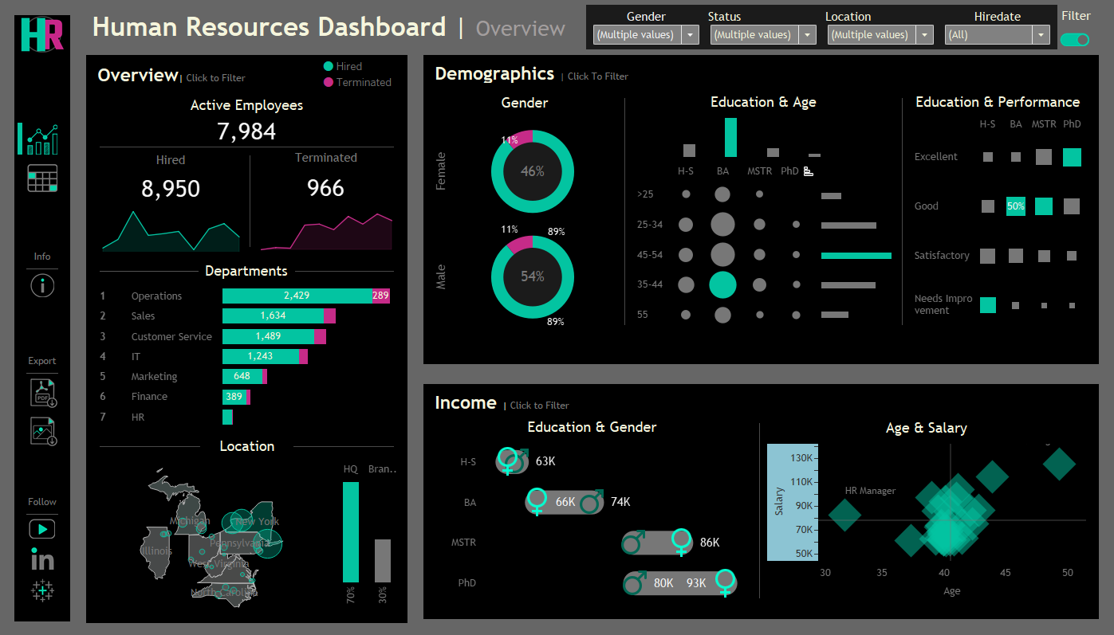
HR Performance Overview Dashboard

Slide 20
